Slide 1
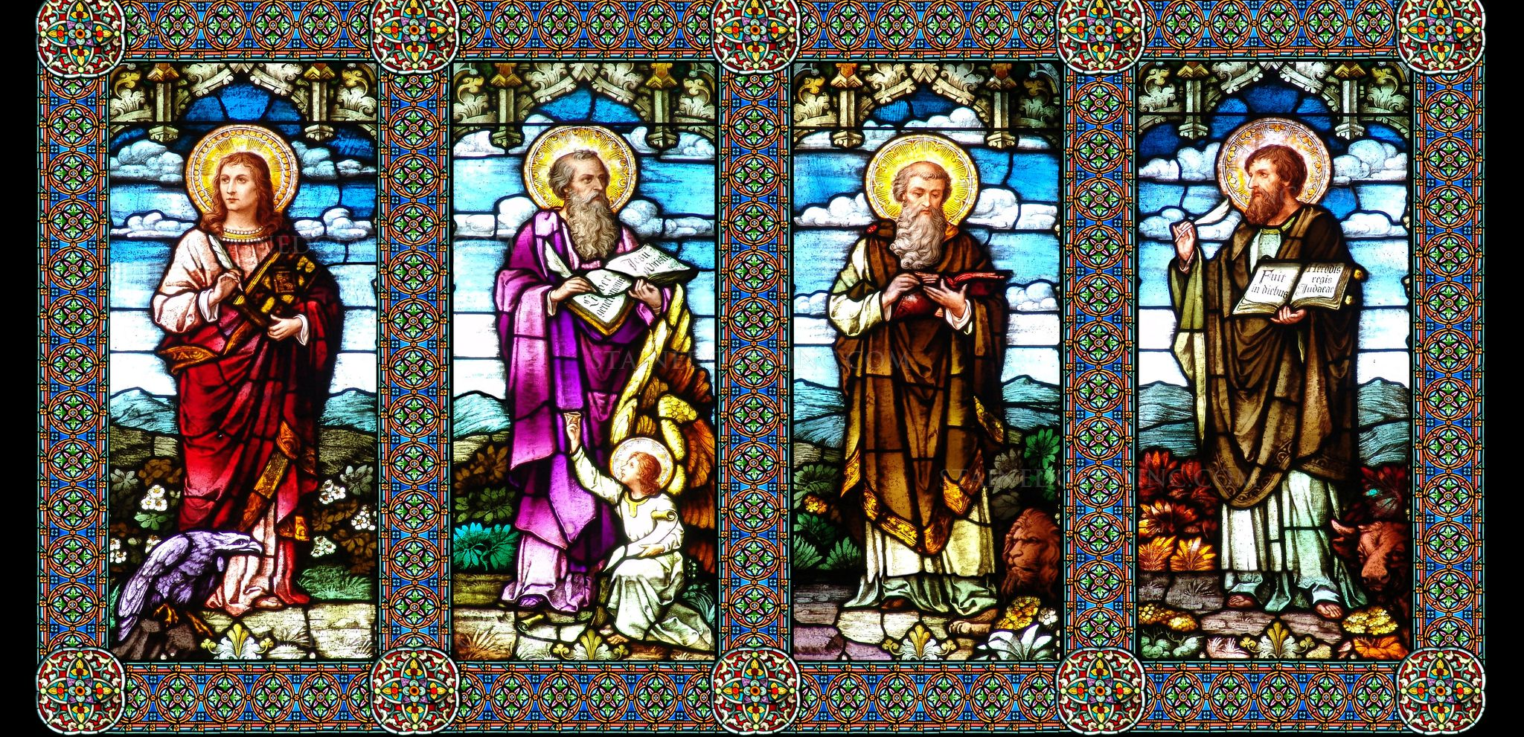
Comparing The Gospels: Class 2
Understanding Mark and Matthew’s Gospels

Slide 2
Reminders from Week 1
Matthew, Mark, and Luke’s Gospels are known as the “Synoptics” due to the significant amount of material they have in common
Although not a universally held view, most scholars believe that Mark was the first Gospel written
Comparative Gospel work comes from seeing how later authors edit, add to, and omit from earlier works

Slide 4
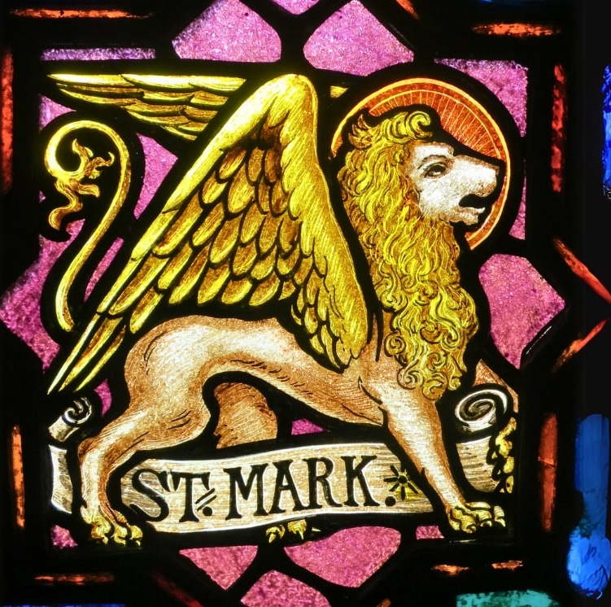
The Gospel of Mark
Jesus,
The Suffering Messiah

Slide 5
Gospel of Mark
Possibly written by a travelling companion of Paul named “John Mark” – Acts 12 + 15
Church fathers state that Mark’s Gospel is derived from sermons given by Peter
Possibly written in Rome, though ancient sources vary – likely written between 66-75 AD due to accuracy of Mark 13 and destruction of Temple

Slide 6
Unique Features of Mark
Shared texts are much more succinct and fast-paced
See handout comparing Mark 1:9-15 vs. Matthew 3:13-4:17
Frequent use of the word “immediately” – εὐθὺς
41 times in Mark, only 9 times in the other three Gospels combined
Significantly shorter overall compared to the other Gospels
Mark – 11,304 words
John – 15,635 words
Matthew – 18,345 words
Luke – 19,482 words

Slide 7
Unique Features of Mark
Misunderstanding is a persistent theme throughout Mark
Not only with religious leaders
Mark 2:1 – 3:6; five conflicts with religious leaders (scribes, Pharisees, and Herodians)
Mark 7:1 – 8:13; contrasts with Pharisees and scribes
Mark 11 + 12 – entry into Jerusalem, conflicts with leaders
…but also the disciples!
“Do you not understand?” – Mark 4:13, 6:52, 8:17, 8:21
“Can you see anything?” – Mark 8:14 – 10:52

Slide 8
Disciples’ Misunderstanding in Mark
From Mark 8 | From Matthew 16 | From Luke 12
“Why are you talking about having no bread? Do you still not perceive or understand? Are your hearts hardened? Do you have eyes and fail to see? Do you have ears and fail to hear…” Then he said to them, “Do you not yet understand?” | “How could you fail to perceive that I was not speaking about bread? Beware of the yeast of the Pharisees and Sadducees!” Then they understood that he had not told them to beware of the yeast of bread but of the teaching of the Pharisees and Sadducees | Meanwhile, when the crowd had gathered by the thousands, so that they trampled on one another, he began to speak first to his disciples, “Beware of the yeast of the Pharisees, that is, their hypocrisy. Nothing is covered up that will not be uncovered and nothing secret that will not become known.

Slide 10
Reframing the Messiah
Mark 8:29-33
Jesus asked them, “But who do you say that I am?” Peter answered him, “You are the Messiah.” And he sternly ordered them not to tell anyone about him. Then he began to teach them that the Son of Man must undergo great suffering and be rejected by the elders, the chief priests, and the scribes and be killed and after three days rise again. He said all this quite openly. And Peter took him aside and began to rebuke him. But turning and looking at his disciples, he rebuked Peter and said, “Get behind me, Satan! For you are setting your mind not on divine things but on human things.”

Slide 11
Reframing the Messiah
Messiah – מָשִׁיחַ – mashiach – “the anointed one”
Appears 39 times in the Old Testament, such as:
Anointed priest in Leviticus
King Saul in 1+2 Samuel
King David in 2 Samuel and Psalms
Cyrus (ruler of Persia!) in Isaiah
Someone yet to come… in Daniel, Habakkuk, and others

Slide 12
350 Years of History in 1 Slide!
From 332-164 BC, Israel was a client state of remnants of Alexander the Great’s short-lived empire, first by the Ptolemaic Kingdom, then the Seleucids c.200 BC
In 164 BC, the Maccabean Revolt established Jewish independence for the first time in centuries
In 64 BC, Rome started getting increasingly involved, with Augustus making Judea a Roman province in 6 AD…

Slide 13
Reframing the Messiah
Prophetic view of a future leader (pre-Exile in 586 BC)
Jeremiah 23:5 – “The days are surely coming, says the Lord, when I will raise up for David a righteous Branch, and he shall reign as king and deal wisely, and shall execute justice and righteousness in the land
“Son of Man” figure in Daniel (roughly 2nd century BC)
Daniel 7:13-14 – “I saw one like a Son of Man coming with the clouds of heaven. And he came to the Ancient One and was presented before him. To him was given dominion and glory and kingship, that all peoples, nations, and languages should serve him. His dominion is an everlasting dominion that shall not pass away, and his kingship is one that shall never be destroyed.”

Slide 14
Reframing the Messiah
In Jesus’ time, there were various theories about who the Messiah would be – fueled by anti-Roman sentiment:
A “Warrior-King” from David’s line, ready to lead an armed rebellion or revolt against Rome
A cosmic “judge of the earth”, more in line with Daniel’s depiction of the “Son of Man”
An authoritative teacher who would correctly interpret God’s Law for the people

Slide 15
Reframing the Messiah
Almost half of Mark’s Gospel is spent reframing the understanding of the Messiah as a “suffering servant”
Jesus’ Ministry in Galilee – Mark 1:14 to 8:21
Culminates in Peter’s declaration that Jesus is the “Messiah” in 8:27-30… but he misunderstands what that means
Jesus’ self-revelation to Disciples – Mark 8:22 to 10:52
Threefold predictions of Jesus’ suffering and death, Transfiguration
Jesus enters Jerusalem, the Passion Narrative – Mark 11:1 to 16:8
From Latin passio, or “suffering” – Mark is arguing that Jesus’ suffering was not a failure of his mission / ministry; it is what makes him The Messiah.

Slide 17
Unique Features of Mark
“Messianic Secret” – why is Jesus constantly telling those he heals, and even the disciples, not to tell anyone who he is?
Mark 3:12 – “But he sternly ordered them not to make him known”
Mark 5:43 – “He strictly ordered them that no one should know this”
Mark 8:30 – “He sternly ordered them not to tell anyone about him”
Running theme of misunderstanding – not wanting to be viewed by the people as a “warrior-king” or someone who is inciting violence against Rome; instead, sacrifices of behalf of God’s people

Slide 18
Careful Structuring in Mark’s Gospel
Mark 2:1-3:6 – 5 conflicts between Jesus and religious leaders
A – Healing
B – Disobedience to Law
C – Fasting / New Wineskins
B’ – Disobedience to Law
A’ – Healing
Mark 8:22-10:52 – Three cycles of Jesus’ self-revelation, framed by stories of Jesus healing those who are blind – all leading into Jesus’ entry into Jerusalem in Mark 11

Slide 19
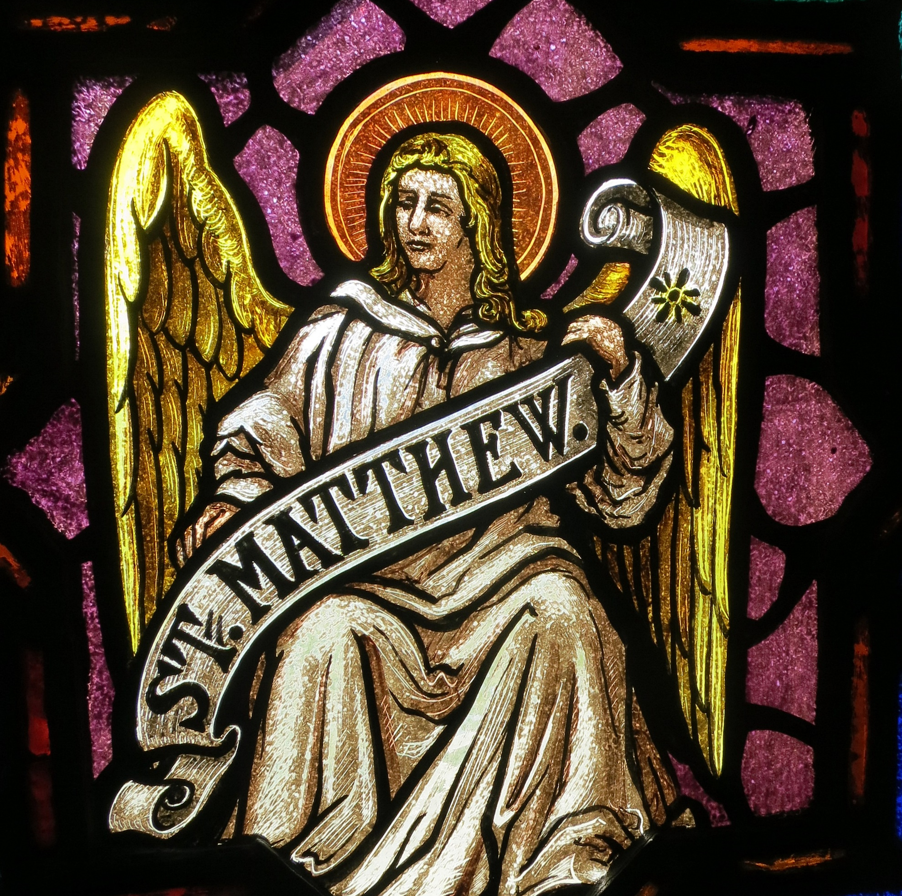
The Gospel of Matthew
Jesus,
The Jewish Messiah

Slide 20
Gospel of Matthew
Early Church Fathers seem to agree that the Gospel author was the same as Matthew, Jesus’ disciple
If first-person experience, why does Matthew seem to use Mark so extensively as a source?
May have been written in Antioch, a major Jewish-Christian site following Jerusalem’s fall in 70 AD

Slide 21
Unique Features of Matthew
Matthew is extremely well-versed in the Hebrew Bible… and drawing connections between Jesus and Old Testament texts.
Matthew 1:14 – Genealogy of Jesus
“So all the generations from Abraham to David are fourteen generations, and from David to the deportation to Babylon, fourteen generations; and from the deportation of Babylon to the Messiah, fourteen generations”
David’s name in Hebrew (dalet-vav-dalet) equates numerically to 4+6+4 as the 4th letter and 6th letter of the Hebrew alphabet
There are five major collections of discourses from Jesus – most famously the Sermon on the Mount… meant to symbolize the Pentateuch / Jesus as New Moses

Slide 22
Unique Features of Matthew
Matthew is constantly quoting from Hebrew scripture and how Jesus connects to “what had been spoken through the prophets”
Within the first 2 chapters of Matthew, there are quotes from:
Isaiah 7:14
Micah 5:2
Hosea 11:1
Jeremiah 31:15
Zechariah 3:8
With allusions to: Genesis 37, Psalm 72, Isaiah 60, Exodus 1 + 30

Slide 23
Unique Features of Matthew
Matthew ratchets up the tension with the religious leaders of Jesus’ day (and potentially Matthew’s day…)
An example from an addition to Mark’s account of Jesus’ baptism:
But when John saw many of the Pharisees and Sadducees coming for his baptism, he said to them, “You brood of vipers! Who warned you to flee from the coming wrath? Therefore, bear fruit worthy of repentance, and do not presume to say to yourselves, ‘We have Abraham as our ancestor,’ for I tell you, God is able from these stones to raise up children to Abraham. Even now the ax is lying at the root of the trees; therefore every tree that does not bear good fruit will be cut down and thrown into the fire.

Slide 24
Unique Features of Matthew
Mark 6:49-52 | Matthew 14:33
But when they saw Jesus walking on the sea, they thought it was a ghost and cried out, for they all saw him and were terrified. But immediately he spoke to them and said, “Take heart, I AM; do not be afraid.” Then he got into the boat with them, and the wind ceased. And they were utterly astounded, for they did not understand about the loaves, but their hearts were hardened. | But when the disciples saw Jesus walking on the sea, they were terrified, saying, “It is a ghost!” And they cried out in fear. But immediately Jesus spoke to them and said, “Take heart, it is I; do not be afraid.” Peter answered him, “Lord, if it is you, command me to come to you on the water.” He said, “Come.” So Peter got out of the boat, started walking on the water, and came toward Jesus. But when he noticed the strong wind, he became frightened, and, beginning to sink, he cried out, “Lord, save me!” Jesus immediately reached out his hand and caught him, saying to him, “You of little faith, why did you doubt?” When they got into the boat, the wind ceased. And those in the boat worshiped him, saying, “Truly you are the Son of God.”

Slide 25
Unique Features of Matthew
The disciples actually seem to understand Jesus in Matthew, and there is a particular place of honor for Peter!
Matthew 16:16-20
Simon Peter answered, “You are the Messiah, the Son of the living God.” And Jesus answered him, “Blessed are you, Simon son of Jonah! For flesh and blood has not revealed this to you but my Father in heaven. And I tell you, you are Peter, and on this rock I will build my church, and the gates of Hades will not prevail against it. I will give you the keys of the kingdom of heaven, and whatever you bind on earth will be bound in heaven, and whatever you loose on earth will be loosed in heaven.” Then he sternly ordered the disciples not to tell anyone that he was the Messiah.

Slide 27
Reframing the Law
From the “Sermon on the Mount” – Matthew 5 to 7
Matthew 5:17 – “Do not think I have come to abolish the law or the prophets; I have not come to abolish but to fulfill”
Matthew 6:5 – “Whenever you pray, do not be lie the hypocrites; for they love stand and pray in the synagogues and at the street corners, so that they may be seen by others”
Matthew 7:12 – “In everything do to others as you would have them do to you; for this is the law and the prophets”
Matthew 7:28 – “Now when Jesus had finished saying these things, the crowds were astounded at his teaching, for he taught as one having authority, and not as their scribes.”

Slide 28
Reframing the Law
Reframing the Law around:
“You shall love the Lord your God with all your heart, and with all your soul, and with all your mind” (from Deuteronomy 6:5)
“You love your neighbor as yourself” (from Leviticus 19:18)
From Bart Ehrman’s The New Testament, chapter on Matthew:
“In sum, it appears as though Matthew assumes most Christians in his community will follow traditional forms of Jewish piety and practices, but ultimately, for him, these are of secondary importance The Law is to be obeyed to the fullest extent possible, but in obeying the Law what really matters is human need. For this reason, love is the greatest commandment, and everything else is subservient to it.”

Slide 29
Week 2 Summary
Gospel of Mark – Jesus, the Suffering Messiah
Likely written with a Gentile audience in mind
Primarily concerned with explaining why the Messiah suffered and died, rather than military revolt, etc.
A story of hope even in the face of suffering
Gospel of Matthew – Jesus, the Jewish Messiah
Almost certainly written with a Jewish audience in mind
Steadily makes connections between Jesus and the Hebrew scriptures, depicting Jesus as a new Moses, bringing an authoritative understanding of the Law – as opposed to the Pharisees / scribes
Reframes disciples as carrying Jesus’ mission forward – Matthew 28

Slide 30
Next Week
Gospel of Luke – The Messiah for All
Gospel of John – The Divine Messiah
Series Wrap-Up

