Slide 1
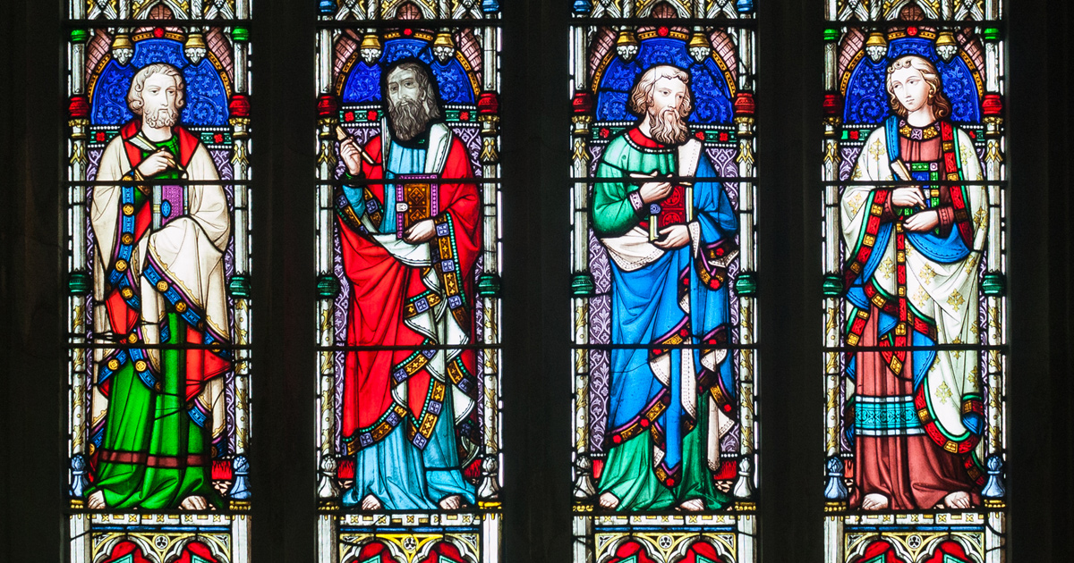
Comparing The Gospels: Class 3
Understanding Luke and John’s Gospels

Slide 2
Reminders from Week 1 + 2
Luke is part of the “Synoptics”– though questions remain about whether Luke was directly adapting Matthew, or if their similarities are due to Mark + “Q”
Slightly over 75% of John’s Gospel is unique from the other three – unclear whether John was directly adapting, or was merely aware of the others
Mark – Jesus as the “Suffering Messiah”
Matthew – Jesus as the “Jewish Messiah”

Slide 3
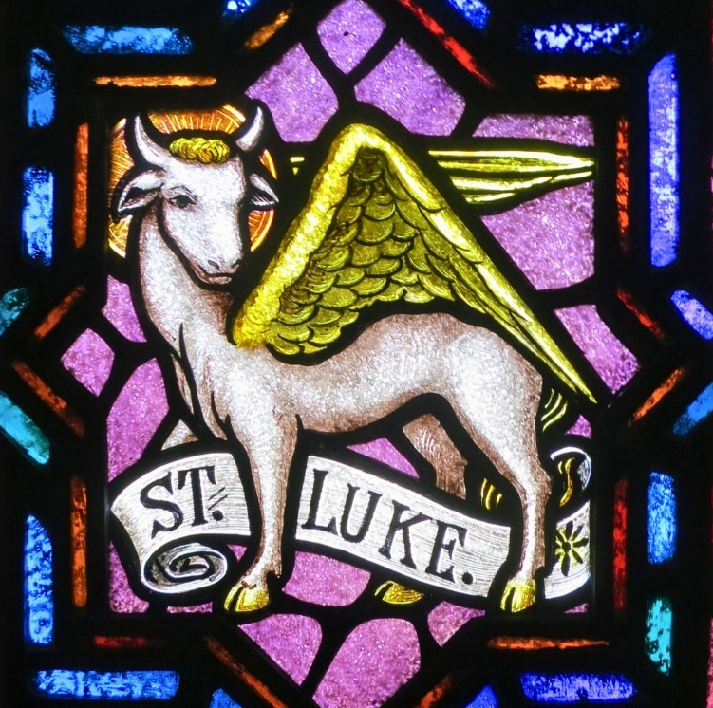
The Gospel of Luke
Jesus,
The Messiah for All

Slide 4
Gospel of Luke
Possibly written by “Luke, the beloved physician” who is mentioned in Colossians 4:14?
Only Gospel to have a “second act” in the Book of Acts, continuing most of the themes seen in Luke
Written in excellent Greek; author seems to have been classically trained and quite knowledgeable

Slide 5
Unique Features of Luke
Jesus as a prophet
Great similarity between Mary in Luke 1 and Hannah in 1 Samuel 1-2
Only Gospel where Jesus raises the son of a widow from Nain in Luke 7 – a clear reference to Elijah doing the same thing in 1 Kings 17
The suffering and rejection Jesus experiences calls to mind Israelite prophets who experienced the same: Elisha, Jeremiah, Ezekiel, Amos
Holy Spirit as an important element of Luke and Acts
Luke – 11 times
Other 3 Gospels combined – 16 times (6, 4, 4)
Acts – 41 times

Slide 6
Unique Features of Luke
11 unique parables in Luke, including two of the most beloved parables that Jesus shared:
Good Samaritan – Luke 10:25-37
Rich Fool – Luke 12:16-21
Prodigal Son – Luke 15:11-32
Dishonest Manager – Luke 16:1-13
Rich Man and Lazarus – Luke 16:19-31
Persistent Widow – Luke 18:1-8
Pharisee and Tax Collector – Luke 18:9-14
Our relationship with material wealth of great importance in Luke

Slide 7
Unique Features of Luke
Consistent theme of the “Great Reversal”
Luke 1:52-53 – “God has brought down the powerful from their thrones, and lifted up the lowly; the Lord has filled the hungry with good things, and sent the rich away empty”
Unique Parables
Good Samaritan – upending bad relations with Samaritans
Prodigal Son – “brother was dead and came to life; he was lost and has been found”
Pharisee and Tax Collector – “all who exalt themselves will be humbled, but all who humble themselves will be exalted”

Slide 9
Jesus: The Messiah of All
Luke 1 – Grounds Jesus in Jewish tradition
Zechariah / Elizabeth: resonances of Abraham/Sarah, Hannah
Gabriel’s announcement: “You will name him Jesus. He will be great, and will be called the Son of the Most High, and the Lord God will give him the throne of his ancestor David. He will reign over the house of Jacob forever, and of his kingdom there will be no end”
Mary’s Magnificat: “God has helped his servant Israel in remembrance of his mercy, according to the promise he made to our ancestors, to Abraham and his descendants forever”
Zechariah’s Prophecy: “Blessed be the Lord God of Israel”
Luke 2 and onwards – Expands Jesus’ ministry to all

Slide 10
Jesus: The Messiah of All
Luke 2 + 3
Shepherds: “I am bringing you good news of great joy for all the people”
Simeon: “It had been revealed to him by the Holy Spirit that he would not see death before he had seen the Lord’s Messiah… ‘My eyes have seen your salvation, which you have prepared in the presence of all peoples, a light for revelation to the Gentiles, and for glory to your people Israel’.
Jesus’ Genealogy
Matthew traces Jesus back to Abraham, emphasizing Davidic lineage
Luke traces Jesus back to Adam, emphasizing Jesus’ connection to all of humanity

Slide 11
Jesus: The Messiah of All
Luke 19:8-10 – Zacchaeus as summary of Luke’s themes
Zacchaeus stood there and said to the Lord, “Look, half of my possessions, Lord, I will give to the poor, and if I have defrauded anyone of anything, I will pay back four times as much.” Then Jesus said to him, “Today salvation has come to this house, because he, too, is a son of Abraham. For the Son of Man came to seek out and to save the lost.”
Culmination of Luke’s “Journey to Jerusalem”
Major central section from Luke 9:51 to 19:27
Almost all of Luke’s unique parables fall in this center section

Slide 13
Acts as an integral part of Luke
Book of Acts follows Jesus’ message spreading across the Roman Empire and beyond
All of Luke’s emphases appear again and again:
Acts 2 – Pentecost and Holy Spirit with disciples
Acts 4 – Believers Share their Possessions
Acts 8 – Ethiopian Eunuch as beginning of “Mission to the Gentiles”
Acts 9 – Saul’s conversation as saving the “lost”
Acts 10 – Cornelius and Peter’s Vision – “I truly understand that God shows no partiality, but in every nation anyone who fears him and does what is right is acceptable to him”

Slide 14
The Gospel of John
Jesus,
The Divine Messiah

Slide 15
Gospel of John
Is the Gospel Writer the “Beloved Disciple”, “John the Elder”, “John of Patmos”, or someone else?
Written in Ephesus(?), at least according to 2nd century church writers
Seems to come from a community experiencing great hardship and expulsion from synagogues

Slide 16
Unique Features of John
Well… the vast majority of it!
Substantial number of passages that don’t appear in any of the other Gospels
Seven “Signs”
Seven “I AM” Discourses
Unique figures that don’t appear in Synoptics
Jesus’ teaching is much more direct and self-revelatory
The timeline of Jesus’ ministry is radically different
Synoptics culminate in Jerusalem, Jesus is there by chapter 2 in John’s Gospel!

Slide 17
Unique Features of John
And yet… not entirely devoid of similarities.
For example, John’s first two chapters:
John 1:1-18 – The Word Became Flesh – Unique
John 1:19-28 – John the Baptist – Clear similarities
John 1:29-36 – The Lamb of God – Adding to Synoptics
John 1:37-42 – Jesus Calls Disciples – Clear similarities
John 1:43-51 – Jesus Calls Nathaniel – Unique
John 2:1-12 – Wedding at Cana – Unique
John 2:13-25 – Cleansing the Temple – Strong similarity in language, but radically different timing from Synoptics

Slide 18
Unique Features of John
Highly improbable that John was written completely independently of the other Gospels:
John the Baptist
Calling of Disciples
Healing on Sabbath
Feeding of 5,000
Jesus Walks on Water
Healing of Blind Man
Jesus’ Entry Into Jerusalem
Last Supper setting
Jesus’ betrayal and arrest
Pilate sentencing, crucifixion

Slide 20
What is behind John’s differences?
Speculations abound – but few certainties on specifics
Pharisees/Religious Leaders vs. “The Jews”
John 9:22 – “For the Jews had already agreed that anyone who confessed Jesus to be the Messiah would be put out of the synagogue”
No evidence of this occurring until the 80’s AD… at the earliest
Increased interactions with John the Baptist
Jewish historian Josephus, writing around 93 AD, records far more about John the Baptist than he does about Jesus
Curious intersections with Proto-Gnostics?
Only Gospel with “Doubting Thomas” – anti-Docetism?

Slide 21
What is behind John’s differences?
One certainty: John’s community was embattled
“And the darkness did not overcome it” – John 1:5
“Whoever comes to me will never be hungry, and whoever believes in me will never be thirsty” – John 6:35
“I will not leave you orphaned” – John 14:18
“If the world hates you, be aware that it hated me before you”
“If they persecuted me, they will persecute you” – John 15:20
“You will have pain, but your pain will turn into joy” – John 16:20
“In the world you face persecution. But take courage; I have conquered the world!” – John 16:33

Slide 22
Jesus, the Divine Messiah
Unlike the “Messianic Secret” of Mark, Jesus is abundantly forthright about his identity:
I AM the bread of life – John 6
I AM the light of the world – John 8
I AM the door for the sheep – John 10
I AM the good shepherd – John 10
I AM the resurrection and the life – John 11
I AM the way, the truth, and the life – John 14
I AM the true vine – John 15

Slide 23
Jesus, the Divine Messiah
Jesus’ closing prayer with the disciples in John 17:
17:1-2 – “Father, the hour has come; glorify your Son so that the Son may glorify you, since you have given him authority over all people, to give eternal life to all whom you have given him”
17:5 – “Glorify me in your own presence with the glory that I had in your presence before the world existed”
17:11 – “Holy Father, protect them in your name that you have given me, so that they may be one, as we are one”
17:21 – “As you, Father, are in me and I am in you, may they also be in us, so that the world may believe you have sent me”

Slide 24
Jesus’ divinity as sign of late authorship?
John has a “High Christology”
Jesus depicted as divine and pre-existent
I AM statements connect to the divine name revealed to Moses
And yet… Philippians 2:5-6
“Let the same mind be in you that was in Christ Jesus, who, though he existed in the form of God, did not regard equality with God as something to be exploited.”
Letter likely written in the late 50’s AD – seems to be quoting something else, which would mean this was already a held view within a decade or two of Christ’s death/resurrection

Slide 25
Jesus, the Divine Messiah
John’s Prologue – “In the beginning was the Word…”
Entirely John’s creation, or based off existing poetry?
Quintessential passage to show John’s “high Christology”
Jesus’ “Final Discourse” from John 13-17
Markedly different from how Jesus speaks in other Gospels, yet unifies themes throughout John’s Gospel (and beyond)
Post-resurrection stories
Far more than any other Gospel – 7 in John, compared to 3 in Luke, 2 in Matthew, and 1(?) in Mark

Slide 26
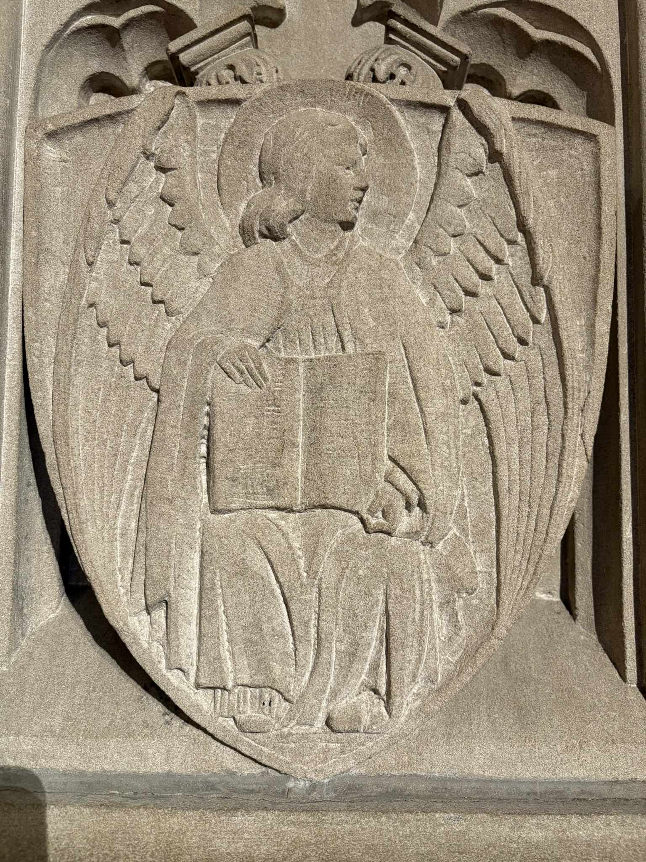
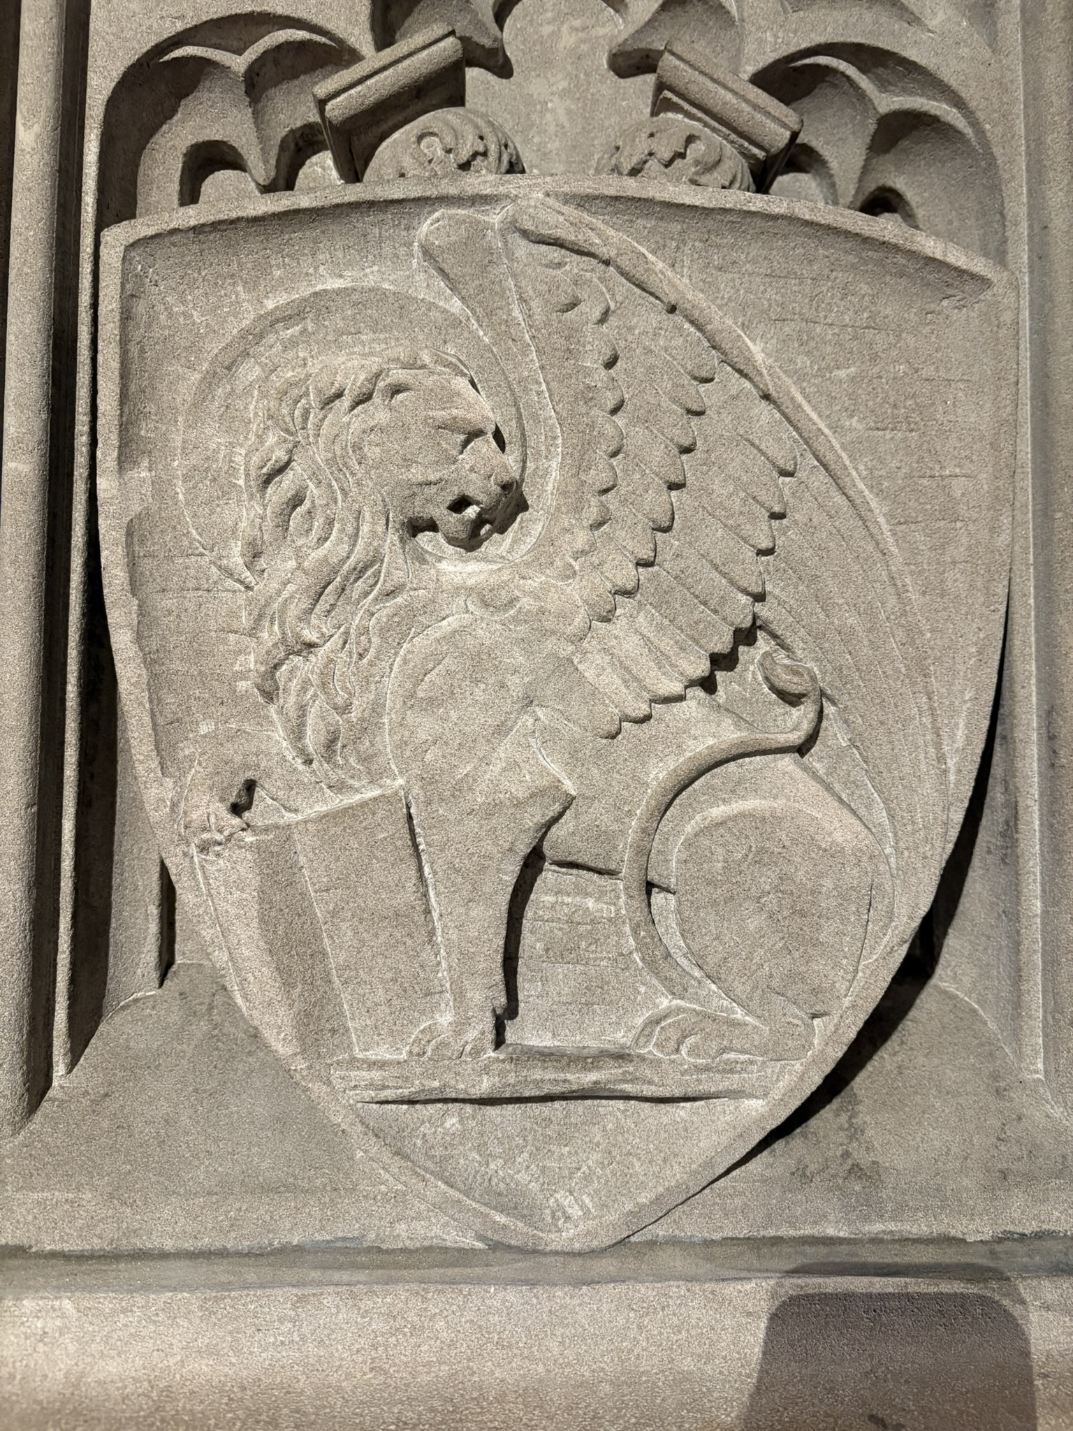
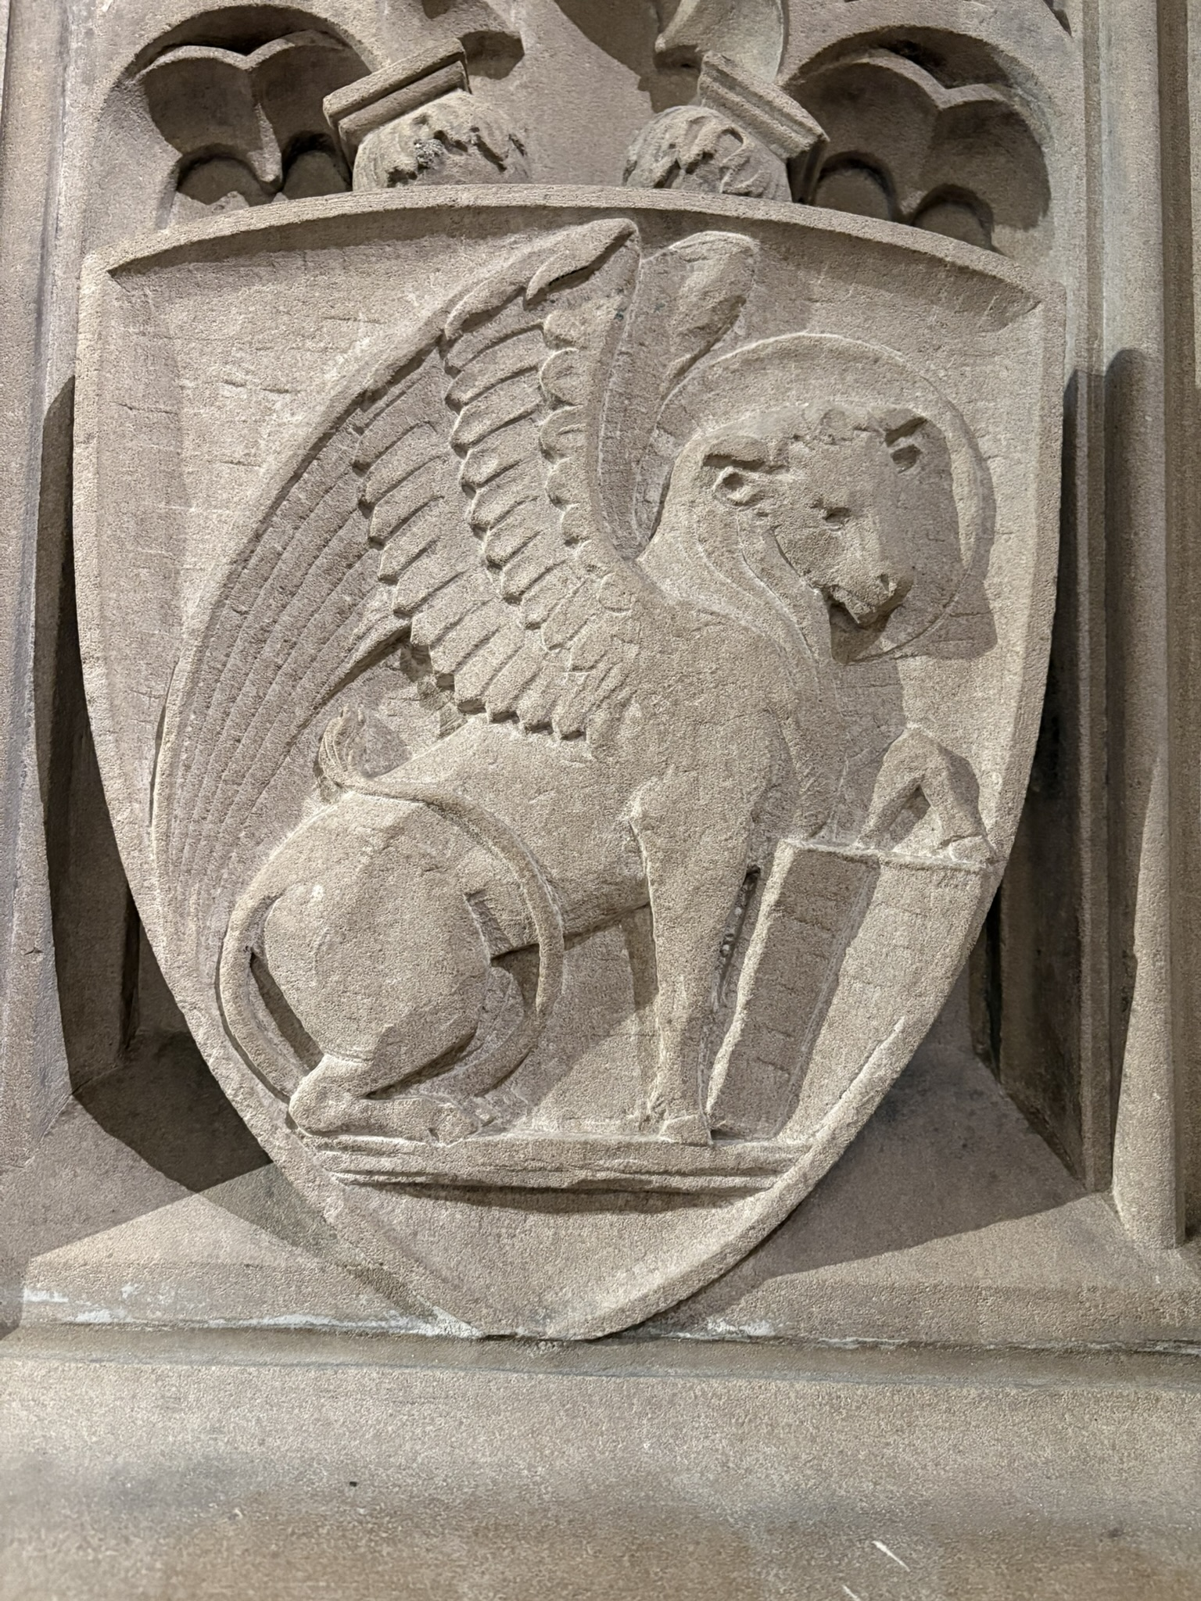
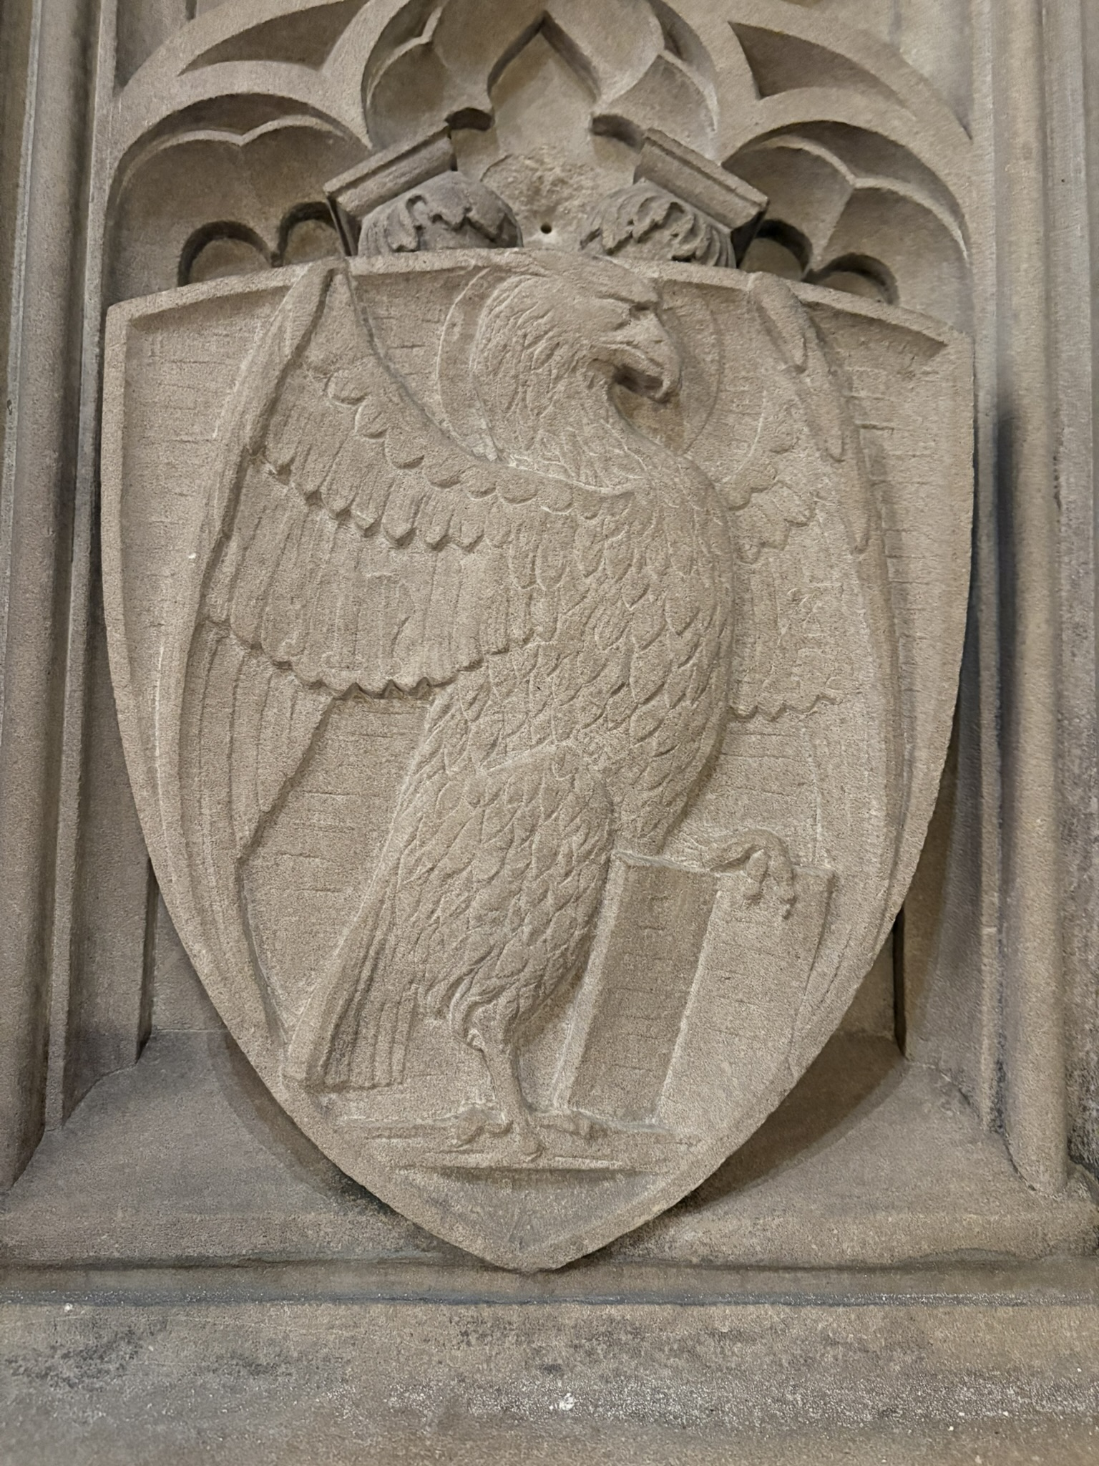

Slide 27
Members of the Early Church
Practicing Jews in and around Jerusalem
Hellenized Jews across the Greco-Roman empire
Gentiles who had little to no experience with Judaism
Those of low status, who could not read or write
Those with years of education, who wrote fluently
Women with wealth, but little societal authority
Itinerant preachers and evangelizers
Many others of whom we know little…

Slide 28
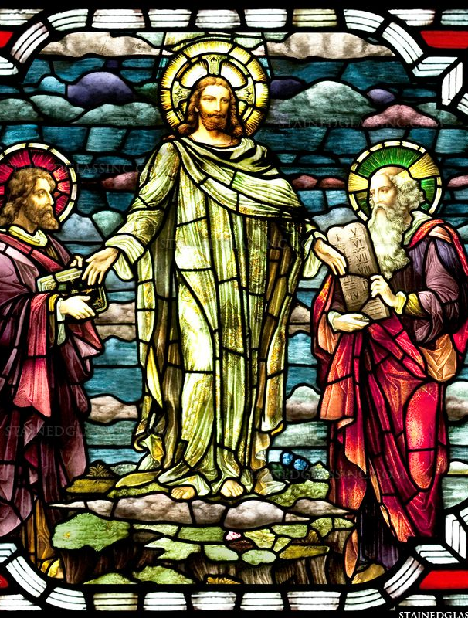
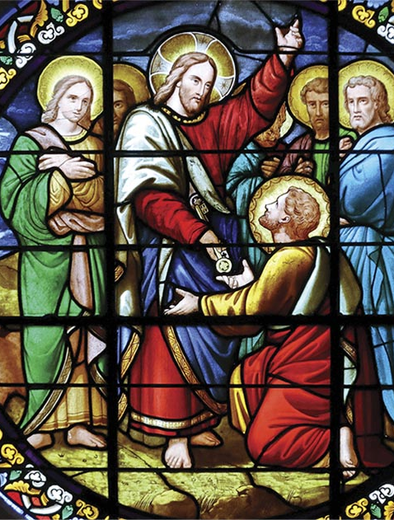
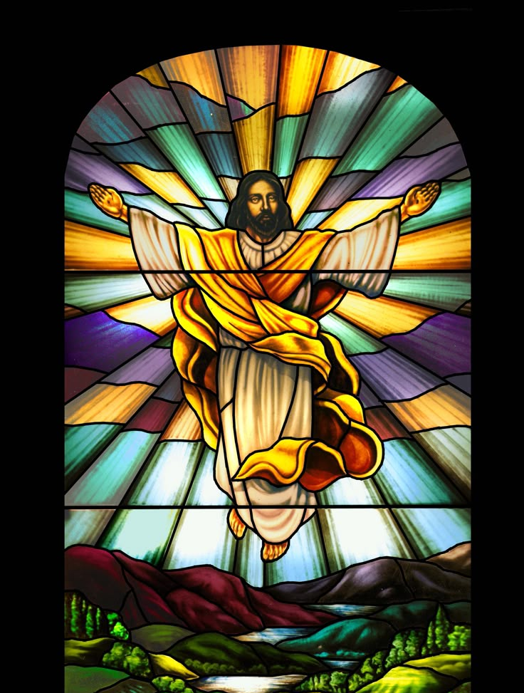
“Who do you say that I am?”

Slide 29
Series Summary
Gospel of Mark – Jesus, the Suffering Messiah
Carefully reshaped the vision of who the Messiah would be against the political expectations of the 1st century
Gospel of Matthew – Jesus, the Jewish Messiah
Shows a clear link for potential Jewish followers of Jesus between the Hebrew scriptures and a new way of following the Law
Gospel of Luke – Jesus, the Messiah of All
Clearly demonstrates Jesus’ concern not only for Israel, but all the world – particularly those with low social status
Gospel of John – Jesus, the Divine Messiah
To follow Jesus is to follow the one true God – and believing in Christ will ensure you rise above the temporary troubles of this world

